Slide 1
More Recursive Data Types
CS 5010 Program Design Paradigms “Bootcamp”
Lesson 4.4
© Mitchell Wand, 2016
This work is licensed under a Creative Commons Attribution-NonCommercial 4.0 International License.
TexPoint fonts used in EMF.
Read the TexPoint manual before you delete this box.: AAA

Slide 2
Introduction
There are other recursive data types besides lists
Programming with these is no different:
write down the data definition, including interpretation and template
Follow the Recipe!

Slide 3
Learning Objectives
At the end of this lesson you should be able to:
Explain what makes a recursive data definition sensible
Explain how the Natural Numbers definition works
write simple programs using the Natural Numbers template

Slide 4
What's interesting about lists?
Our Lists data definitions are the first "interesting" data definitions:
They are mixed data
They are recursive
Question: Why did we say "data definitions" instead of data definition?"
Answer: Remember that we have a data definition ListOfX for each X

Slide 5
What makes a good definition for mixed data?
The alternatives are mutually-exclusive
It is easy to tell the alternatives apart
There is one and only one way of building any value.

Slide 6
Example of a bad data definition
A Blue number is one of
an integer that is a multiple of two
an integer that is a multiple of three
These categories are not mutually exclusive

Slide 7
Example of a bad data definition
A Green number is one of
an integer that is a product of exactly two prime numbers
any other integer
These categories are mutually exclusive, but it is complicated to distinguish them

Slide 8
Example of a bad data definition
A Purple number is one of
the number 1
a number of the form (+ n1 n2)
Just knowing the value of a purple number, like 56, doesn't tell you how it was constructed as (+ n1 n2) . There are many choices of n1 and n2 that would build 56.

Slide 9
The Natural Numbers
The natural numbers are the counting numbers:
0, 1, 2, 3, 4, ...
This is just another name for the non-negative integers

Slide 10
A data definition for the natural numbers
;; A Natural Number (Nat) is one of
;; -- 0
;; -- (add1 Nat)
Here we use the Racket function add1, which adds 1 to its argument. We'll also use sub1, which subtracts 1 from its argument.

Slide 11
Examples
0
1 (because 1 = (add1 0))
2 (because 2 = (add1 1))
3 (because 3 = (add1 2))
4 (because 4 = (add1 3))
Etc...

Slide 12
Is this a good data definition?
Are the alternatives mutually exclusive?
Is it easy to tell the alternatives apart?
Answer: yes
Answer: yes, with the predicate zero?

Slide 13
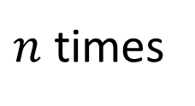
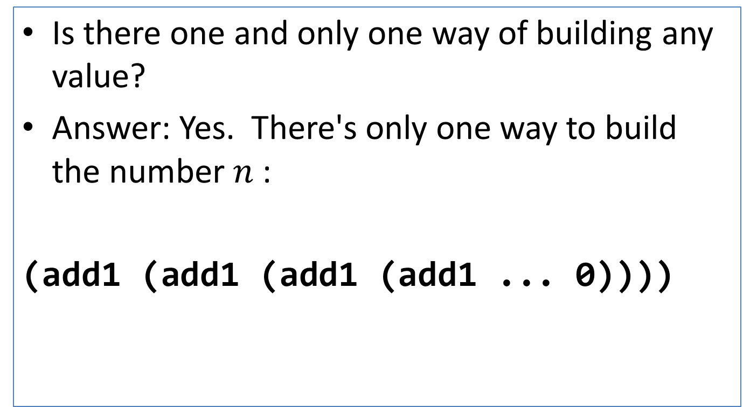
Is this a good data definition? (2)
Is there one and only one way of building any value?
Answer: Yes. There's only one way to build the number $n$ :
(add1 (add1 (add1 (add1 ... 0))))
$n$ times

Slide 14
Is this a good data definition? (3)
If we have a natural number x of the form (add1 y), there's only one possible value of y. Can we find it?
Answer: sure. If x = (add1 y), then y = (sub1 x).
So add1 is like a constructor, and sub1 is like an observer.
This leads us to a template:

Slide 15
Template
;; nat-fn : Nat -> ??
(define (nat-fn n)
(cond
[(zero? n) ...]
[else (... n (nat-fn (sub1 n)))]))

Slide 16
double
;; double : Nat -> Nat
;; strategy: use template for
;; Nat on n
(define (double n)
(cond
[(zero? n) 0]
[else (+ 2 (double (sub1 n)))]))

Slide 17
sum
;; sum : Nat Nat -> Nat
;; strategy: use template for
;; Nat on x
(define (sum x y)
(cond
[(zero? x) y]
[else (add1 (sum (sub1 x) y))]))

Slide 18
Example
(sum 3 2)
= (add1 (sum 2 2))
= (add1 (add1 (sum 1 2)))
= (add1 (add1 (add1 (sum 0 2))))
= (add1 (add1 (add1 2)))
= 5

Slide 19
product
;; prod : Nat Nat -> Nat
;; strategy: use template for
;; Nat on y
(define (prod x y)
(cond
[(zero? y) 0]
[else
(sum x (prod x (sub1 y)))]))

Slide 20
Example
(prod 2 3)
= (sum 2 (prod 2 2))
= (sum 2 (sum 2 (prod 2 1)))
= (sum 2 (sum 2 (sum 2 (prod 2 0))))
= (+ 2 (+ 2 (+ 2 0)))
= 6

Slide 21
Summary
At the end of this lesson you should be able to:
write down the definition for non-negative integers as a data type
use the template to write simple functions on the non-negative integers and other simple recursive data types.
The Guided Practices will give you some exercise in doing this.

Slide 22
Next Steps
Study 04-3-nats.rkt in the Examples file
If you have questions about this lesson, ask them on the Discussion Board
Do Guided Practice 4.4++
Go on to the next lesson
Guided Practices (to be written): recur on the other argument; expt;
left-nested lists

